Slide 1

Session 2

Slide 2
Recap of DevOps Introduction 1
What is DevOps
What was used before DevOps
How DevOps idea emerged
Agile vs DevOps
Architectures using in SDLC

Slide 3
DevOps Career Roadmap
Cloud & Containers
CI/CD
Scripting
Monitoring
Configuration management
Source code management
Operating system

Slide 4
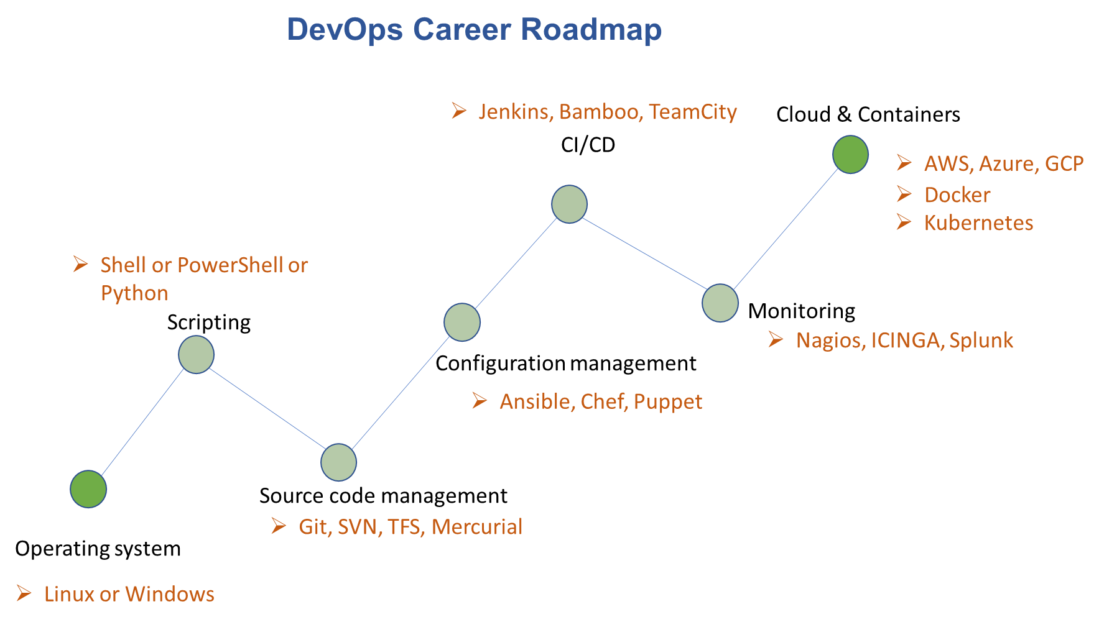

Slide 5
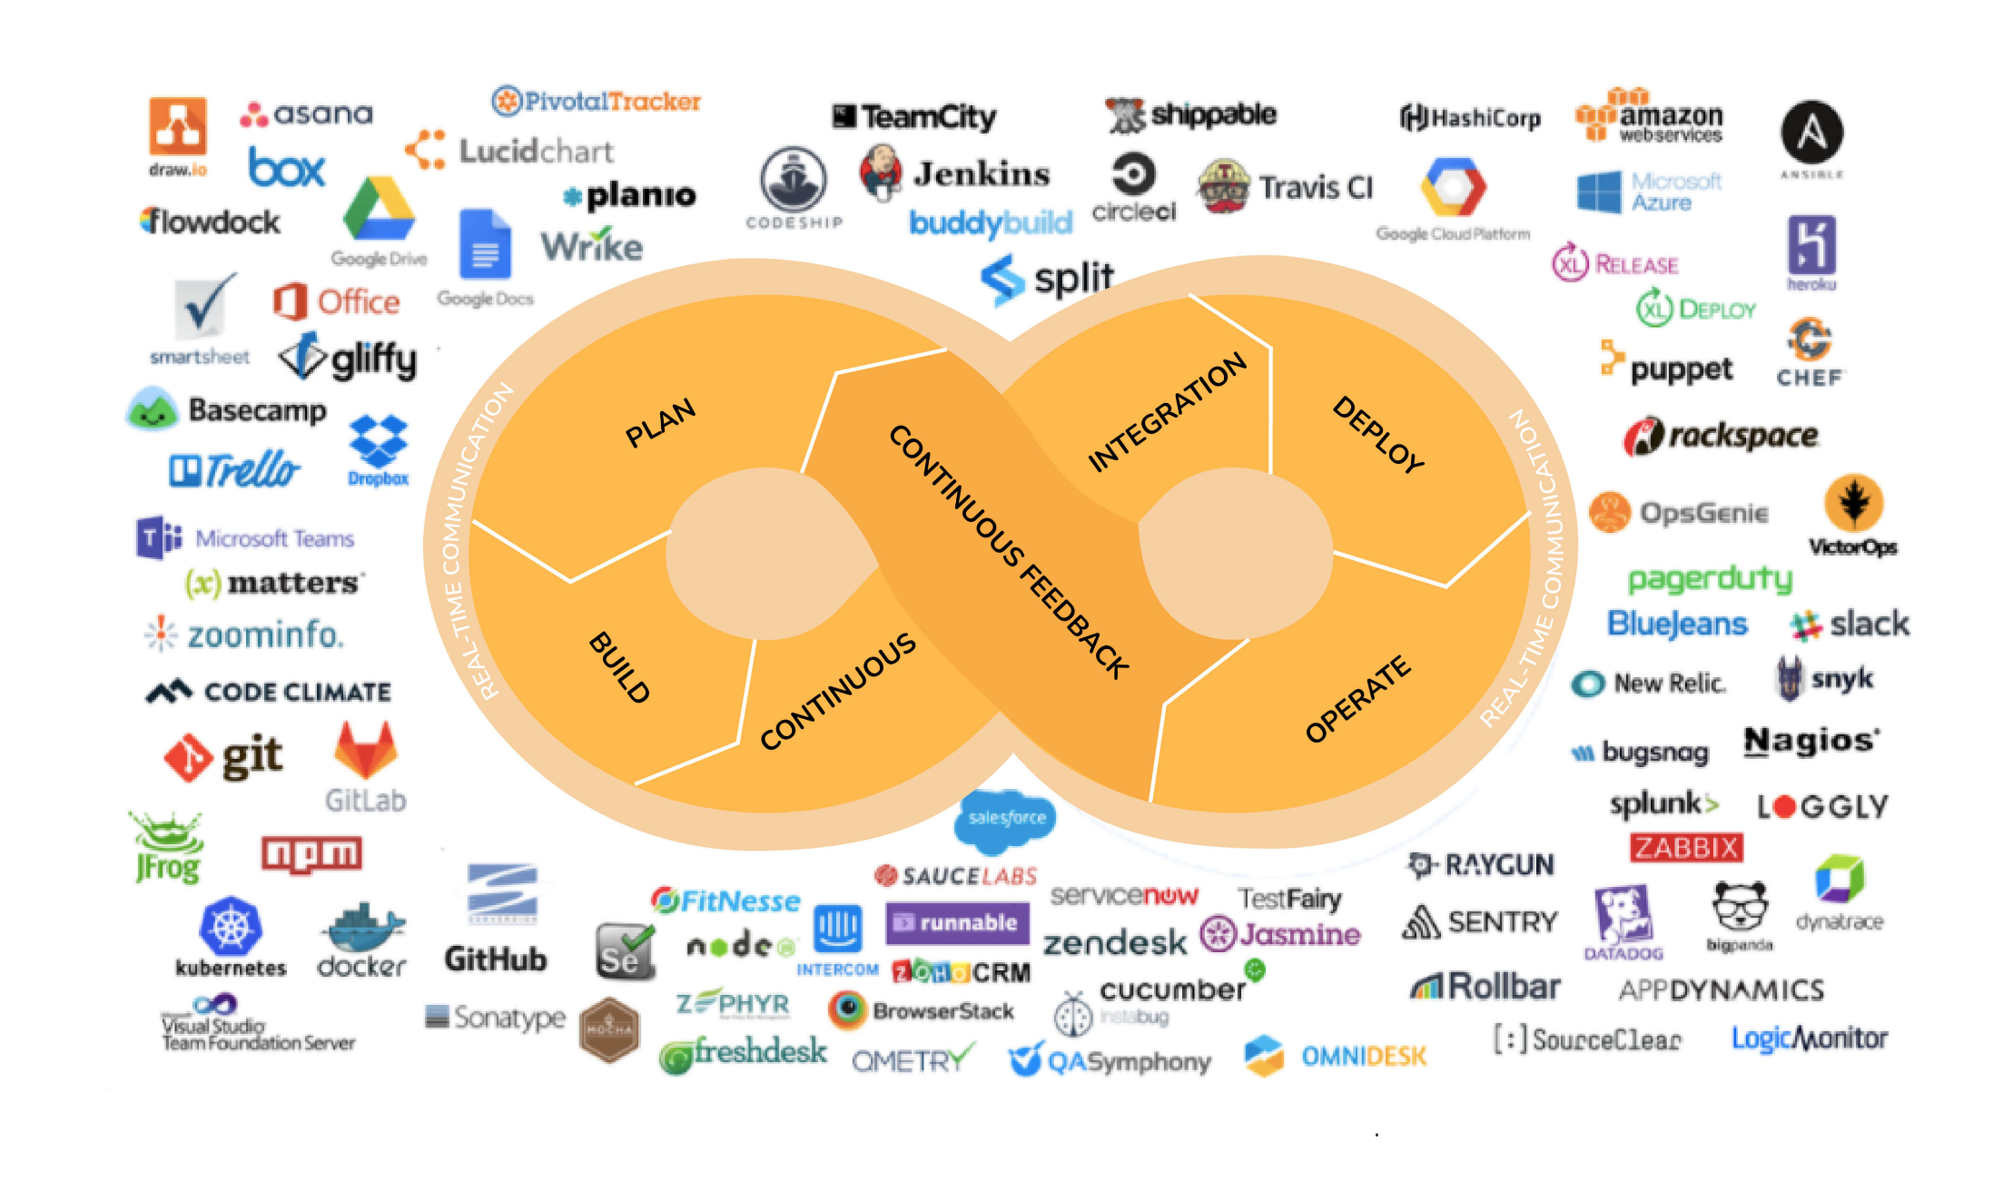

Slide 6
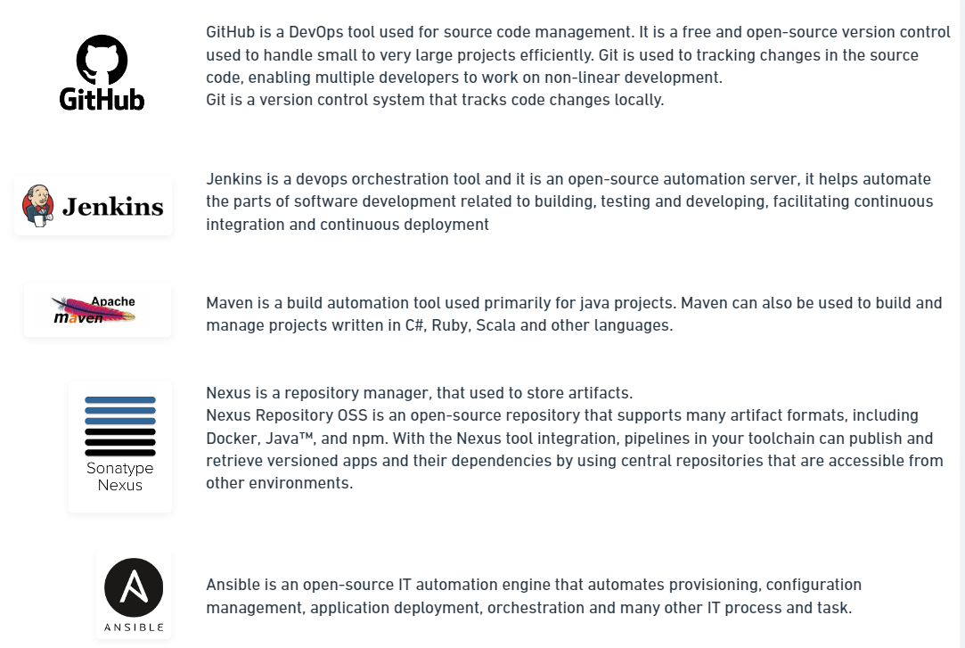
DevOps tolls walk-through

Slide 7
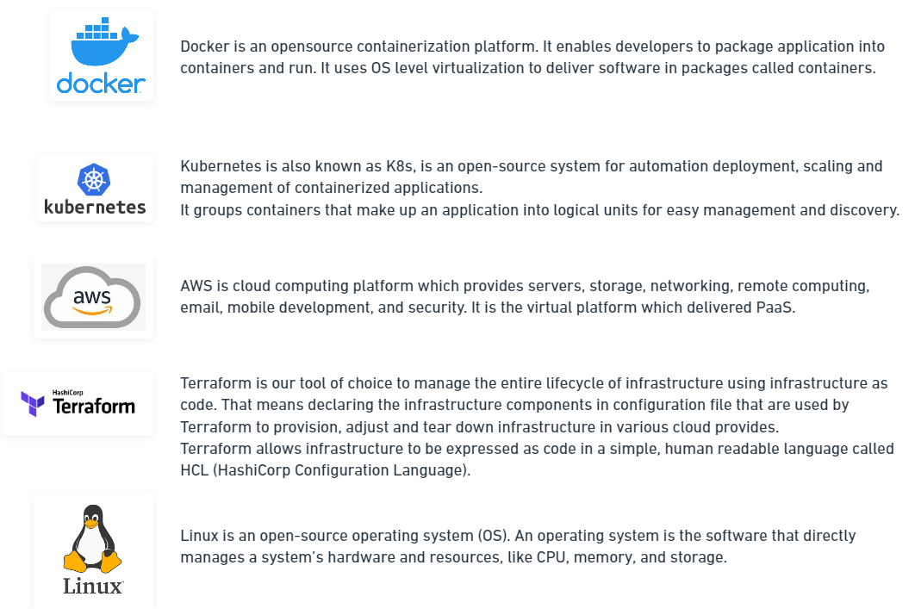
DevOps tolls walk-through

Slide 8
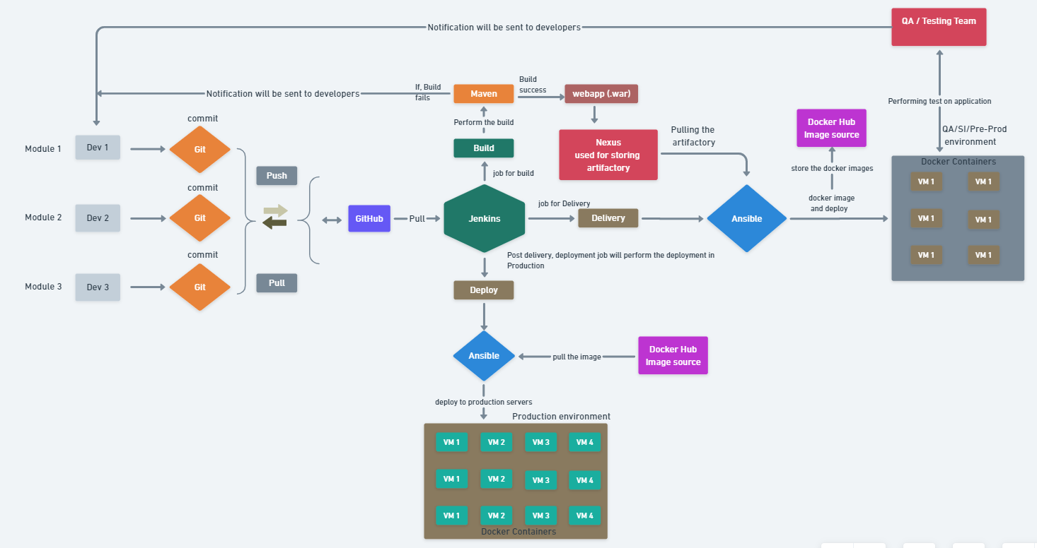
Simple DevOps work flow

Slide 9


